Slide 1
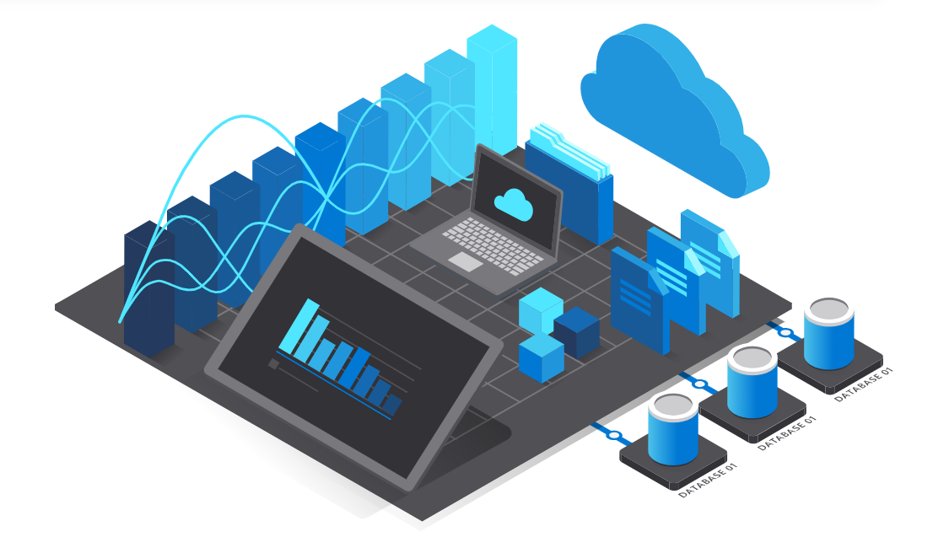
Cloud Computing

Slide 2
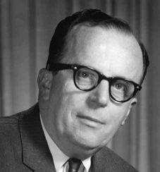
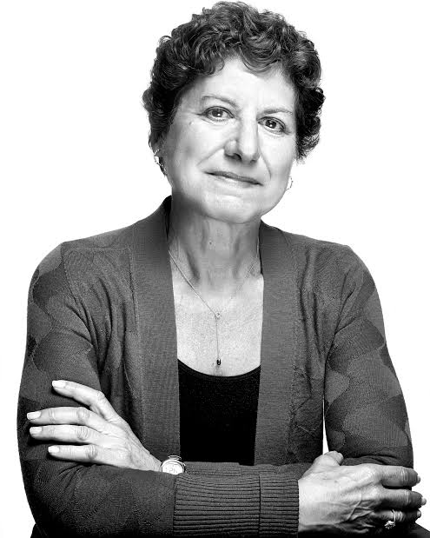
Father & Mother
Father
Joseph Carl Robnett Licklider (J.C.R. Linklider)
Mother
Judy Estrin

Slide 3
Cloud Computing
Cloud computing is defined as the use of hosted services, such as data storage, servers, databases, networking, and software over the internet.

Slide 4
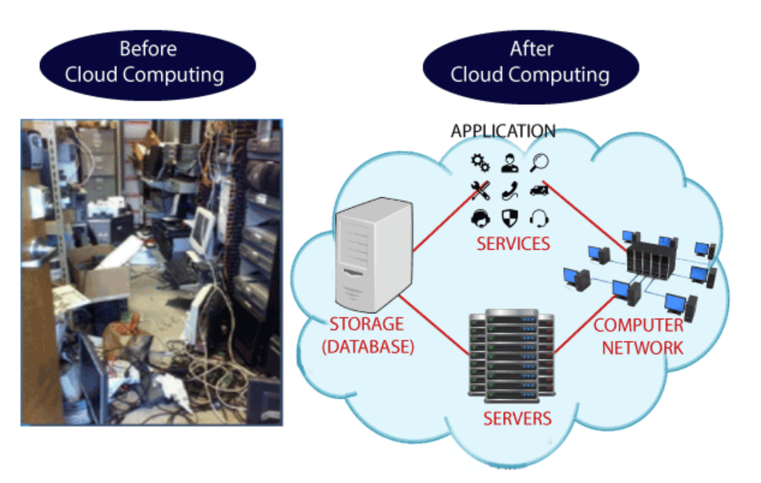
Why Cloud Computing?

Slide 5
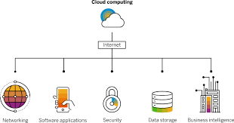

Slide 6
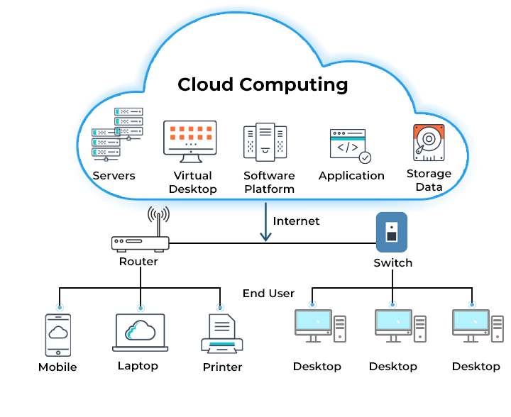
Cloud Computing Architecture

Slide 7
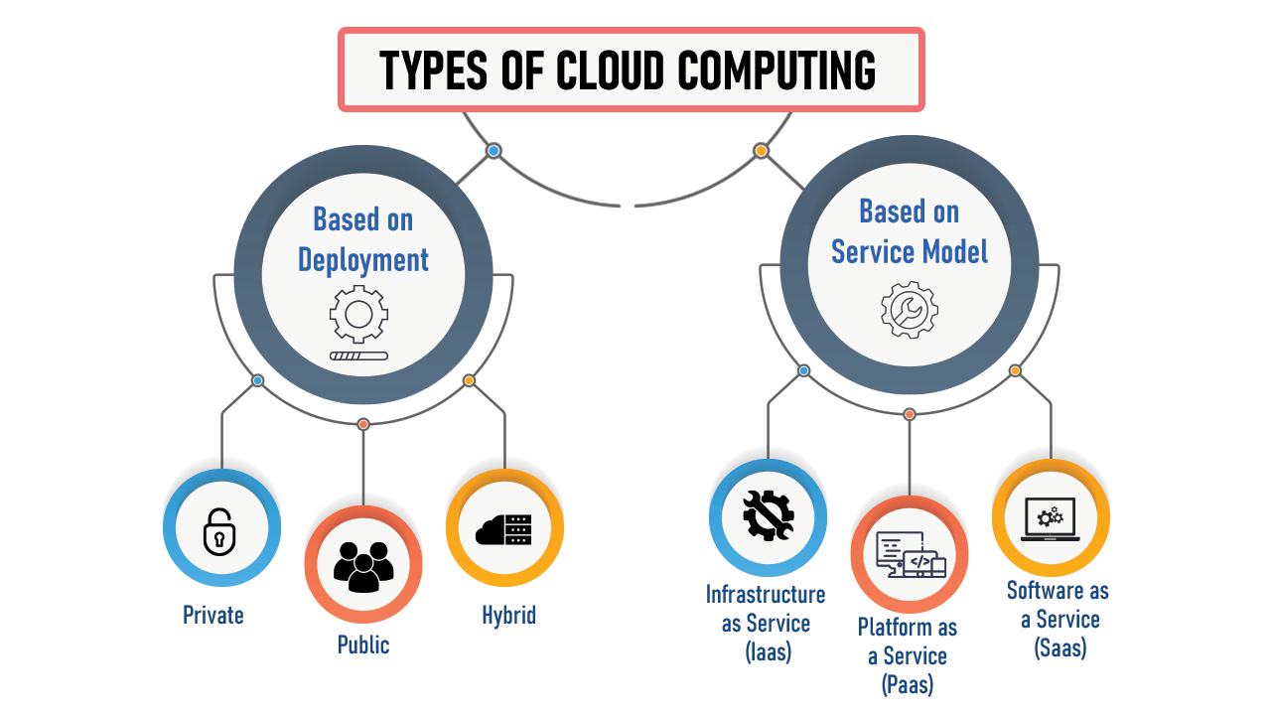

Slide 8
Cloud computing services
IaaS (Infrastructure-as-a-Service),
PaaS (Platform-as-a-Service) and
SaaS (Software-as-a-Service)

Slide 9
IaaS (Infrastructure-as-a-Service)
IaaS provides on-demand access to fundamental computing resources—physical and virtual servers, networking, and storage—over the internet on a pay-as-you-go basis.
IaaS enables end users to scale and shrink resources on an as-needed basis, reducing the need for high, up-front capital expenditures or unnecessary on-premises or ‘owned’ infrastructure and for overbuying resources to accommodate periodic spikes in usage.
IaaS provides the users with the lowest-level control of computing resources in the cloud when PaaS computing models such as containers and serverless.

Slide 10
PaaS (Platform-as-a-Service)
PaaS provides software developers with on-demand platform—hardware, complete software stack, infrastructure, and even development tools—for running, developing, and managing applications without the cost, complexity, and inflexibility of maintaining that platform on-premises.
PaaS, the cloud provider hosts everything—servers, networks, storage, operating system software, middleware, databases—at their data center.
PaaS is often built around containers. Containers virtualized the operating system, enabling developers to package the application with only the operating system services.
E.g. – Docker and Kubernetes

Slide 11
SaaS (Software-as-a-Service)
SaaS—also known as cloud-based software or cloud applications—is application software that’s hosted in the cloud, and that users access via a web browser, a dedicated desktop client, or an API that integrates with a desktop or mobile operating system.
The cost savings, time-to-value, and scalability benefits of cloud, SaaS offers the following:
Automatic upgrades
Protection from data loss

Slide 12
Types of cloud computing
Public Cloud
Private cloud
Hybrid cloud
Multicloud and hybrid multicloud

Slide 13
Public Cloud
Public clouds are owned and operated by third-party cloud service providers, which deliver computing resources like servers and storage over the internet.
Public cloud, all hardware, software, and other supporting infrastructure is managed by the cloud provider. You can access these services and manage your account using a web browser, API, or CLI.

Slide 14
Private cloud
A private cloud refers to cloud computing resources used exclusively by a single business or organization.
A private cloud can be physically located in the company’s on-site data center.
Some companies also pay third-party service providers to host their private cloud.
A private cloud environment maintains the services and infrastructure on a private network.

Slide 15
Hybrid cloud
Hybrid cloud offers a combination of public and private clouds, networked together in such a way that data and applications can be shared between them.
Hybrid clouds offer businesses greater flexibility for scaling and deployment.

Slide 16
Multicloud
Multicloud computing entails using multiple cloud computing services from more than one cloud provider for the same type of IT solutions or workloads.
A multicloud strategy—which may include both private and public clouds—helps organizations mitigate risk and offers them increased workload flexibility.
Choosing different offerings and capabilities from more than one cloud provider enables organizations to build solutions that are best suited to their specific IT needs.

Slide 17
Kinds of Cloud Services
Email
Storage, backup, and data retrieval
Creating and testing apps
Analyzing data
Audio and video streaming
Delivering software on demand

Slide 18
List of Company providing services
Google Cloud
Amazon Web Services (AWS)
Microsoft Azure
IBM Cloud
Alibaba Cloud

Slide 19
Cloud security
Shared responsibility for security
Data encryption
User identity and access management
Collaborative management
Security and compliance monitoring

Slide 20
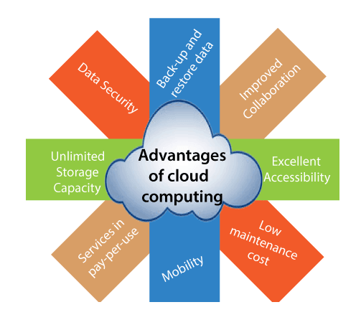

Slide 21
Challenges of cloud computing
Downtime
Internet connection dependency
Financial commitment
Security risks
Limited access

